Slide 1
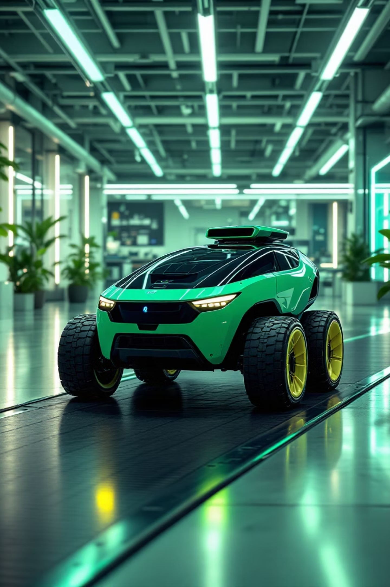
Autonomous Path Following Rover
AI CODEx
M. Jahanzaib 22-NTU-CS-1363
M. Talha 22-NTU-CS-1366
Safder Rehman 22-NTU-CS-1371

Slide 2

Project Overview
IoT-based autonomous rover
Follows predefined paths
Uses Reinforcement Learning
Real-time monitoring interface

Slide 3



Problem & Goal
Industrial Need
Growing demand for autonomous path-following systems
Our Goal
Cost-effective rover using AI, IoT, and cloud tech

Slide 4
Project Objectives
1
Build tape-following rover
2
Train with RL in Unity
3
Deploy on Raspberry Pi
4
Create monitoring website
5
Firebase data logging

Slide 5
Tools & Technologies
Hardware
Software & Cloud
Raspberry Pi
Unity + ML-Agents
DC Motors + Shield
MicroPython
Camera Module
Firebase
Lithium Battery
Next.js
Metal Chassis
HTTP/WebSocket

Slide 6

Reinforcement Learning Model
Unity Simulation
Virtual environment for safe, accelerated training
Reward Function
Based on time spent following tape path
GPU Training
Used FYP Lab systems for efficient processing

Slide 7
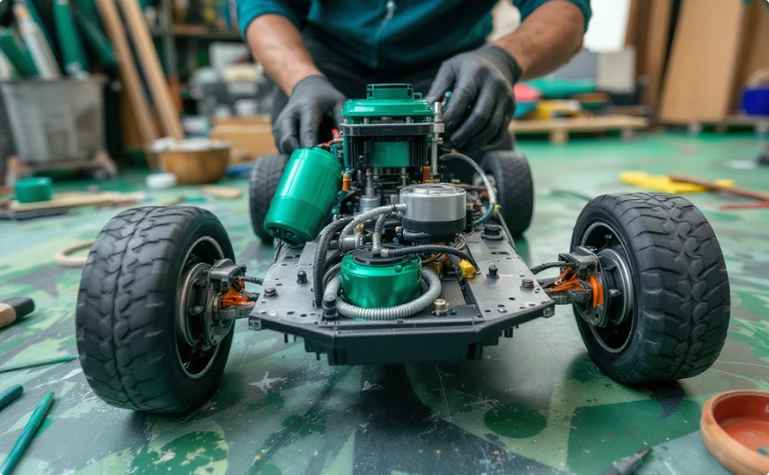
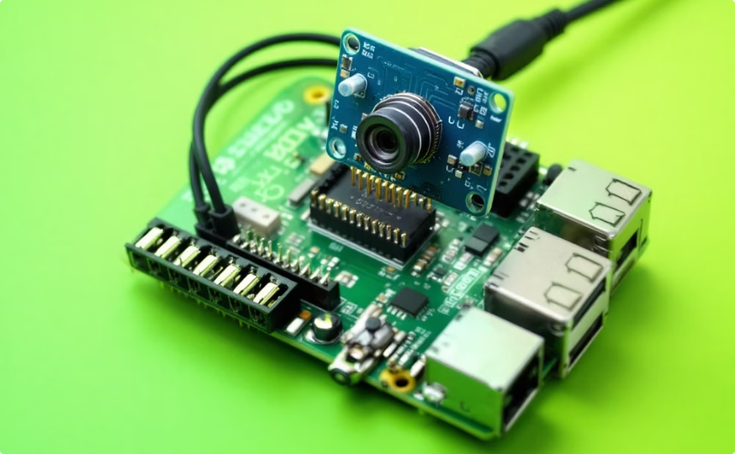
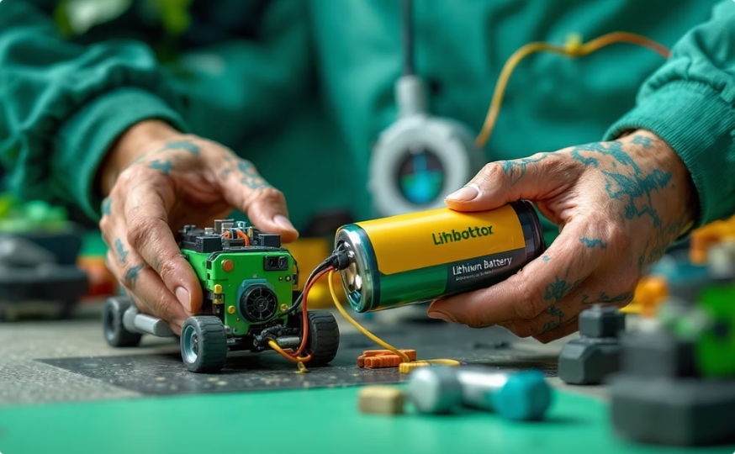
Physical Construction
Chassis & Motors
Base structure with 4 DC motors for mobility
Control System
Pi as brain, camera for vision,
driver for motors
Power System
Lithium battery pack for portable operation

Slide 8








Web Interface
Intro Page
Product Page
Project overview
Component details
Auto Drive
Control Page
Live camera feed
Manual operation

Slide 9
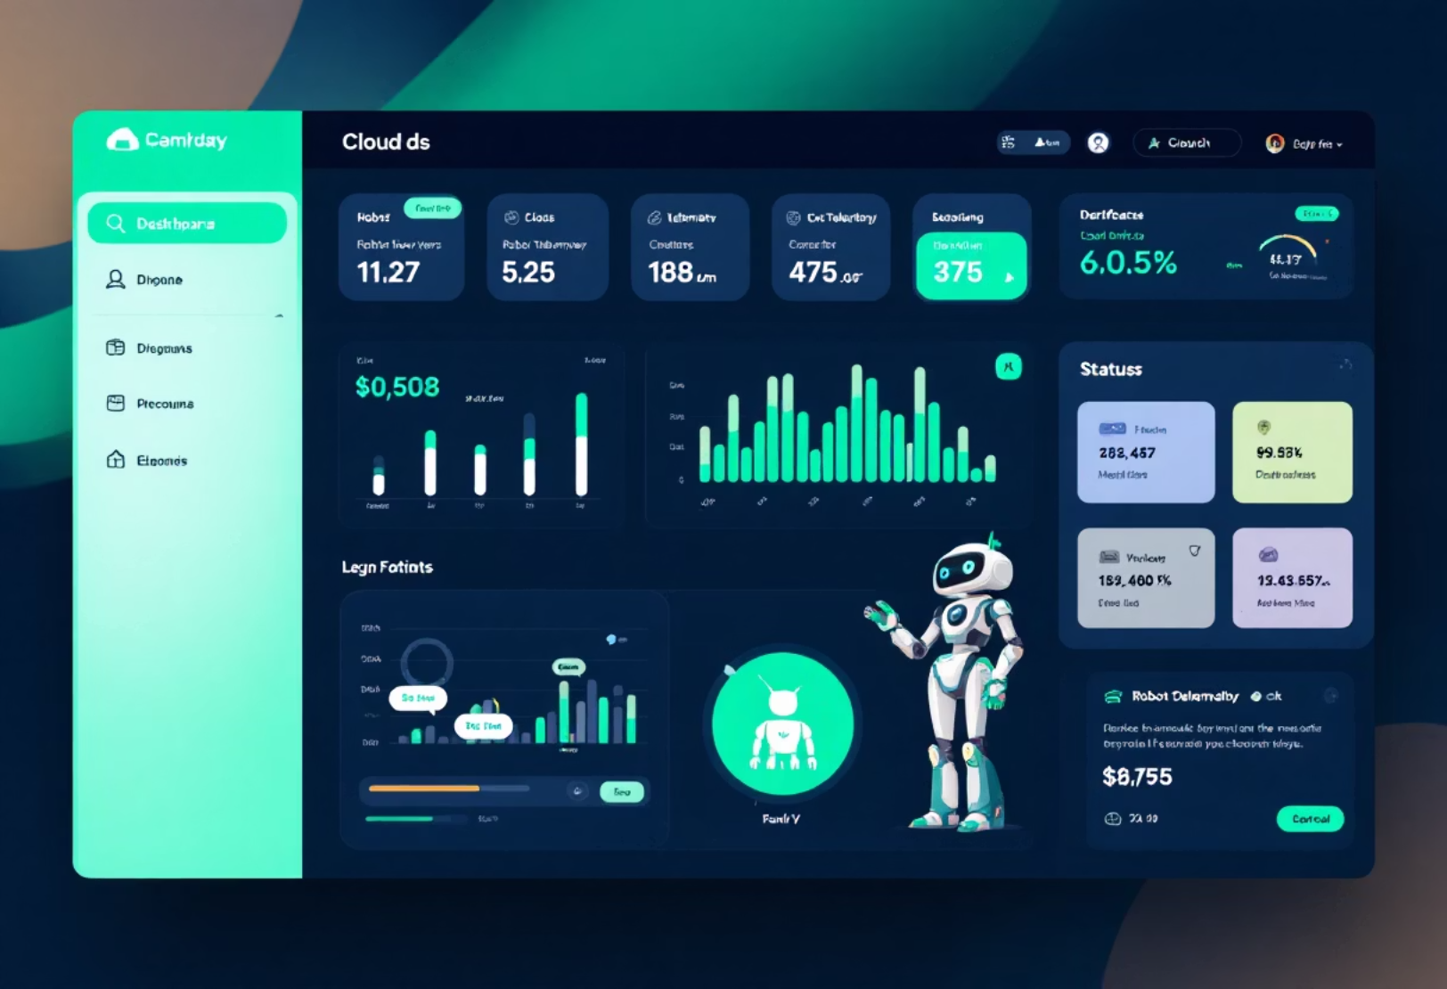
Cloud Integration
Firebase Services Used
Realtime Database
Cloud Storage
Data Logged
Speed readings
Battery status
Error logs
Camera images

Slide 10





System Architecture
Unity Simulation
Virtual training environment
Trained RL Model
Optimized navigation algorithm
Raspberry Pi
Motor control + camera input
Firebase
Data storage and logging
Web Interface
User monitoring and control

Slide 11
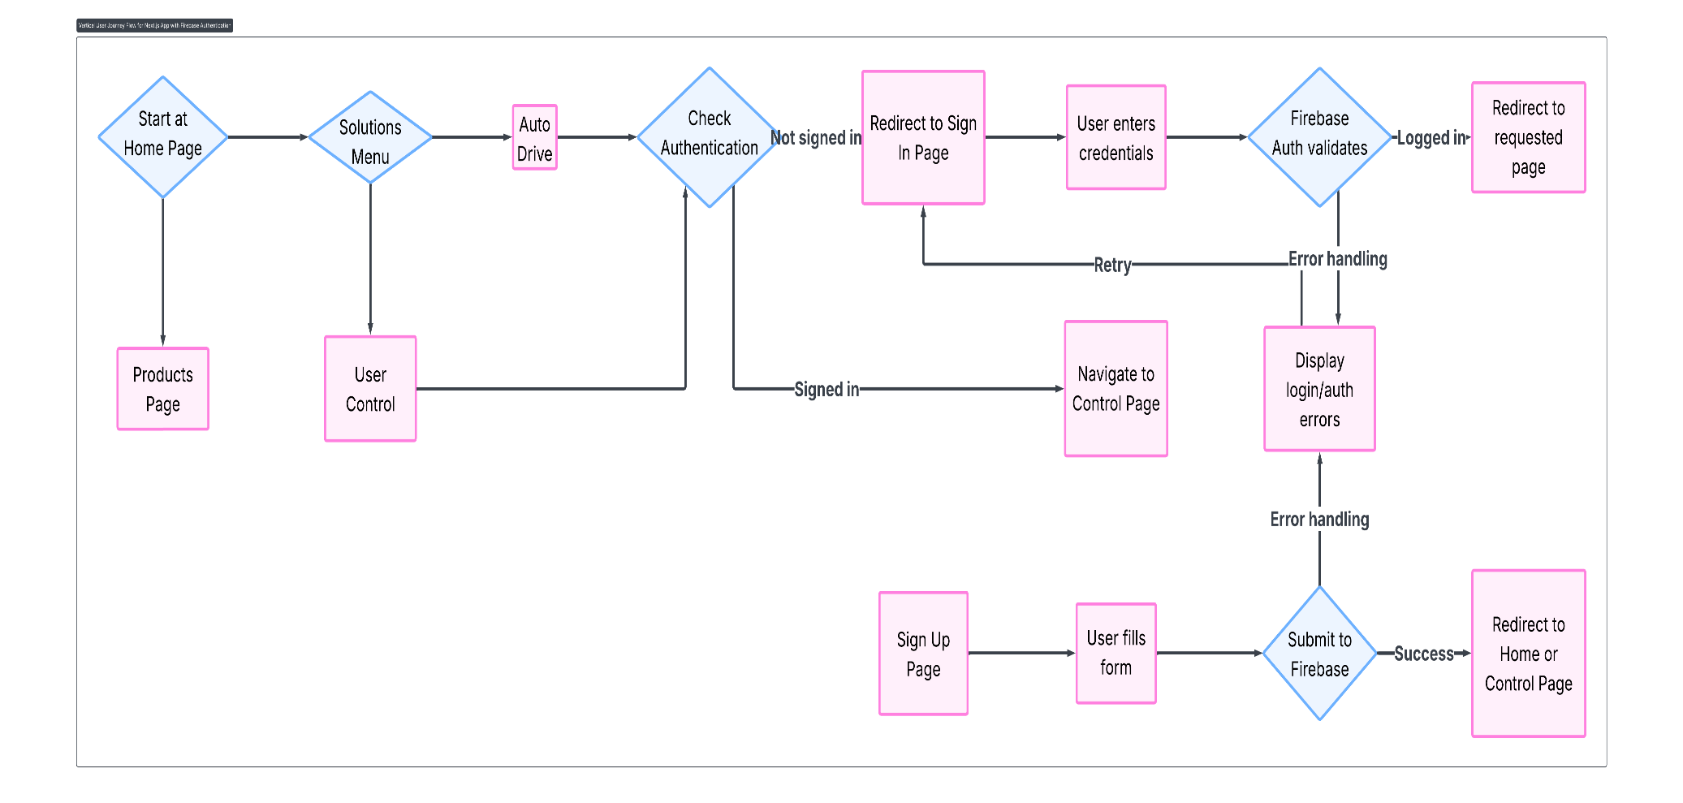
Flow Diagram

Slide 12
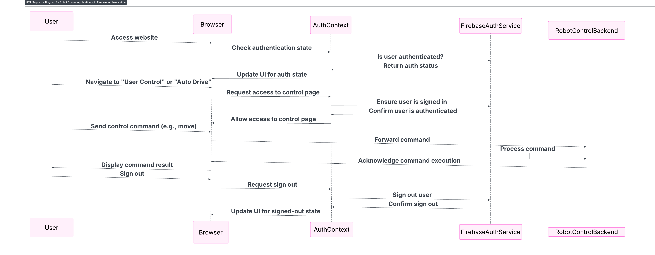
Sequence Diagram

Slide 13
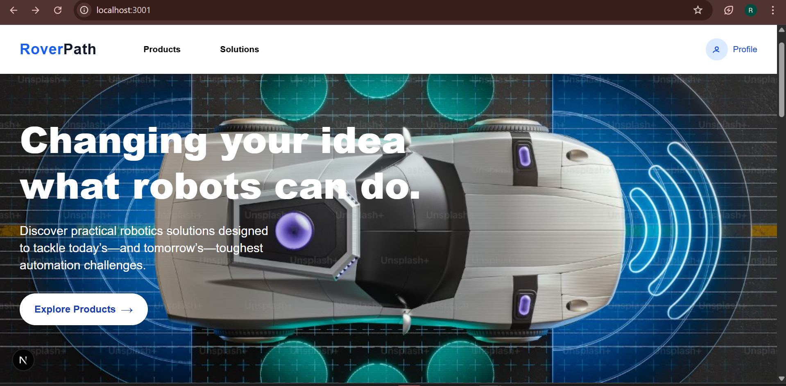

Slide 14
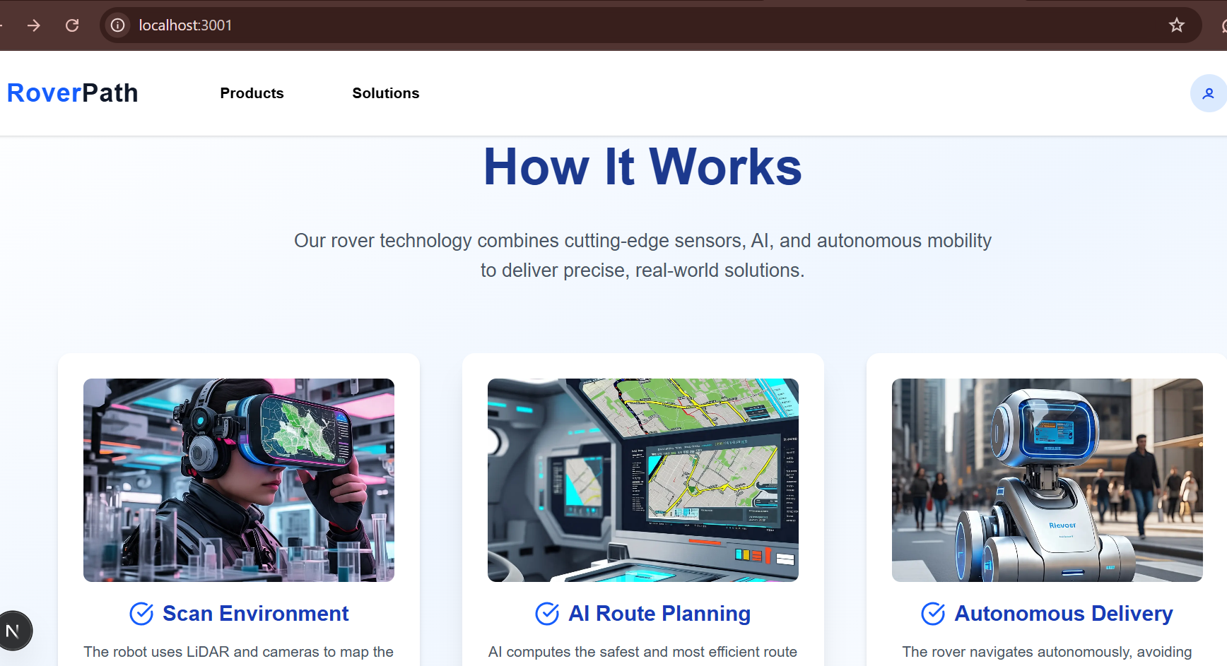

Slide 15
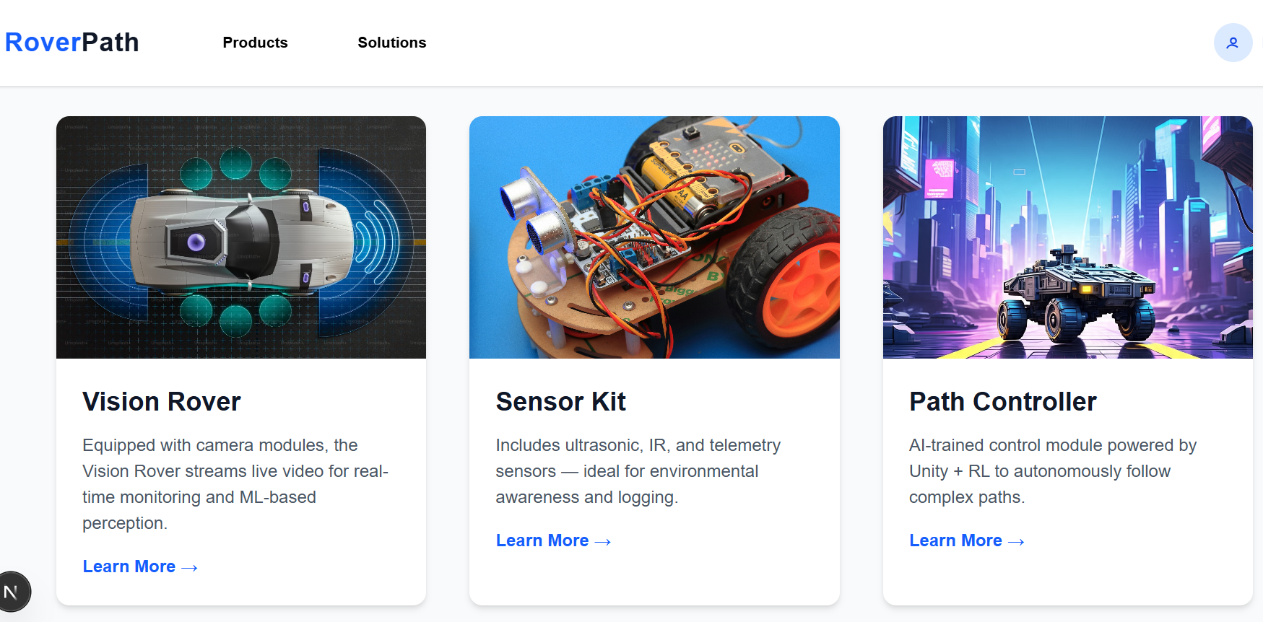
Products

Slide 16
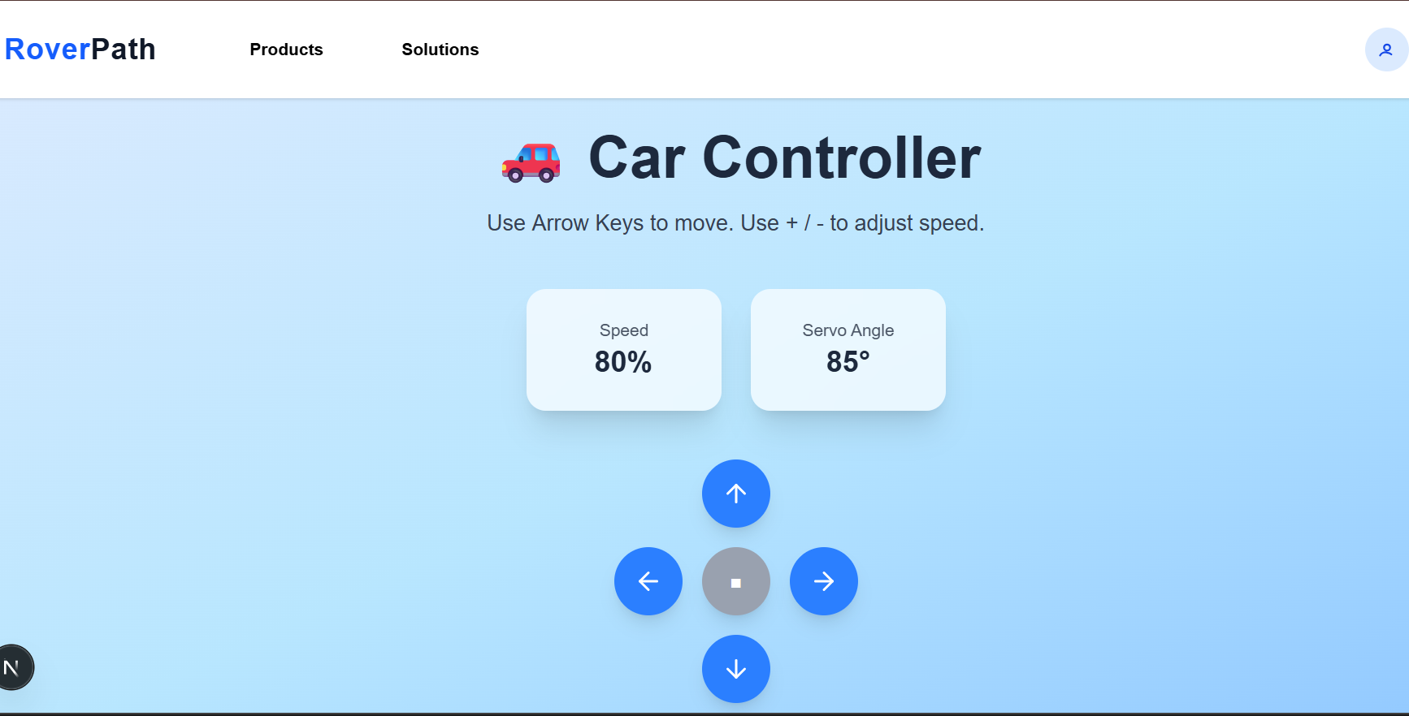

Slide 17
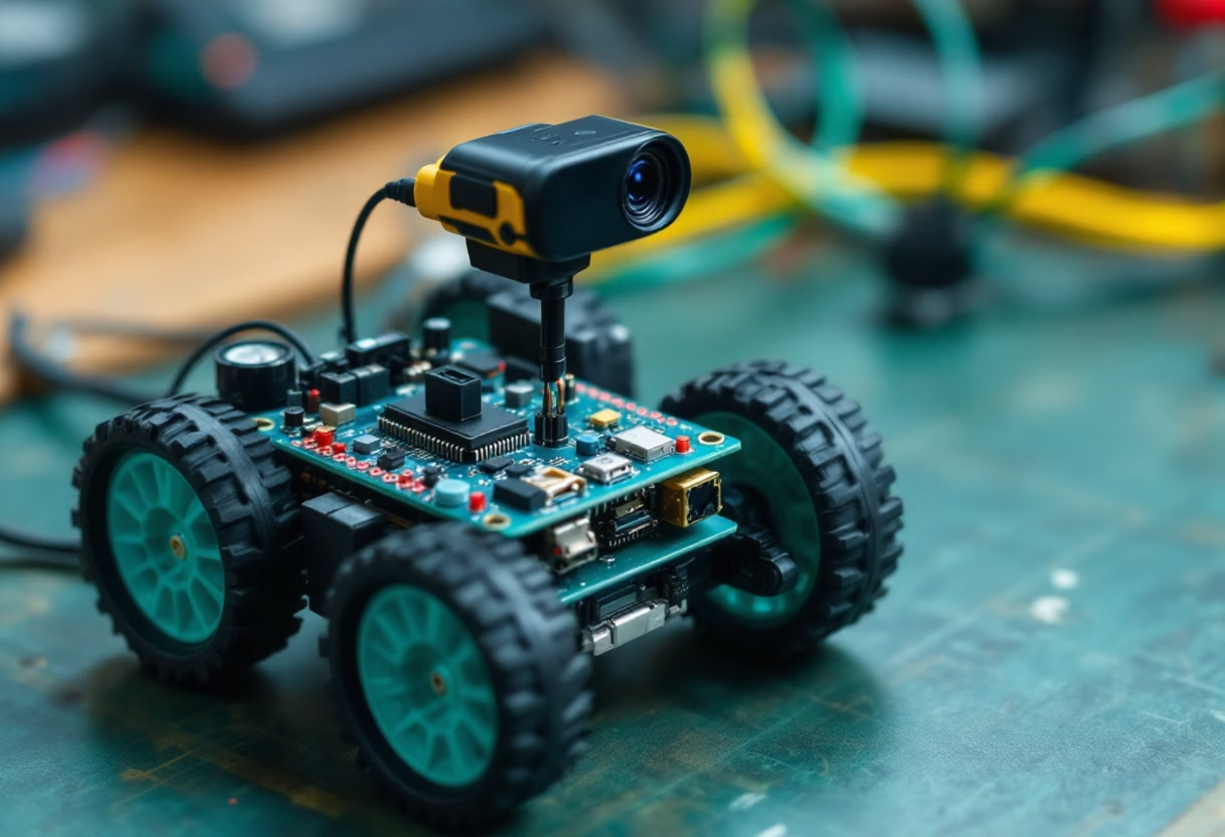
Testing and Integration
RL model deployed to MicroPython
Testing on black tape path
Motor power optimization
Website-rover sync verified

Slide 18
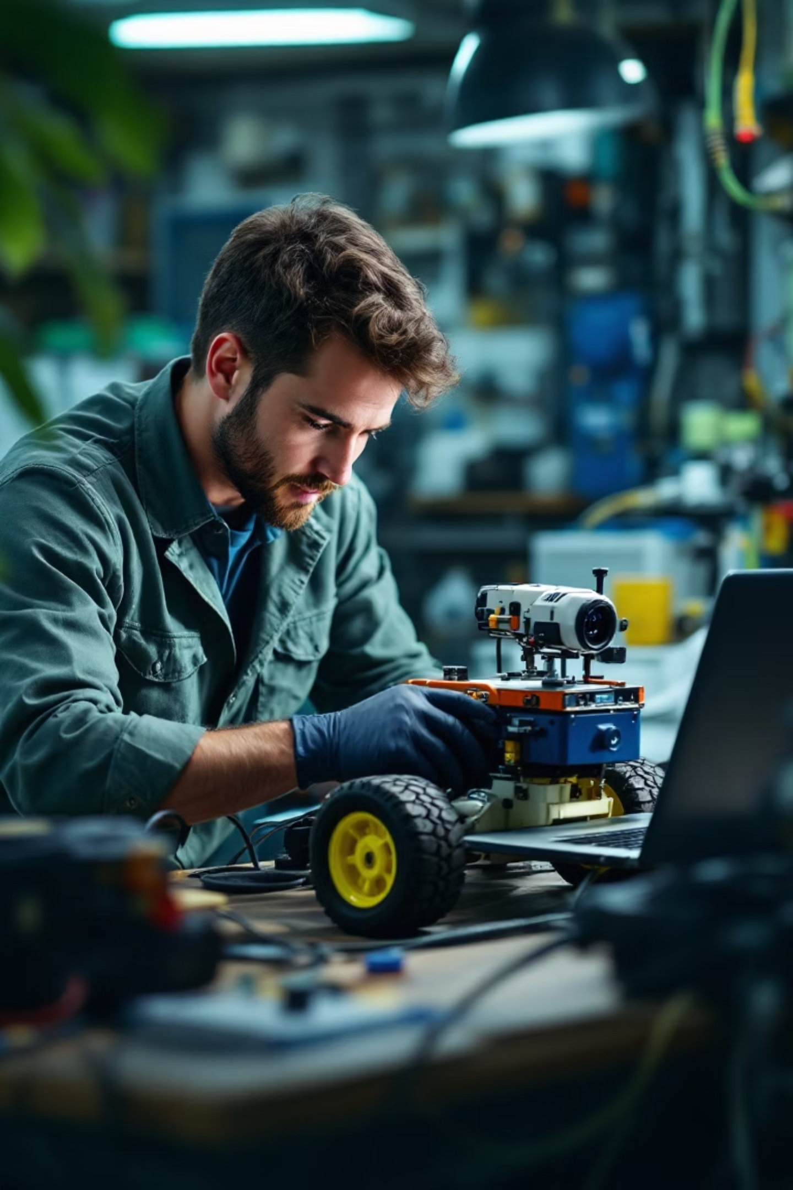




Challenges Faced
Unity-MicroPython compatibility
Model translation issues between environments
Video streaming limitations
Raspberry Pi processing constraints
WiFi fluctuations
Connection drops during live control
Hardware calibration
Motor and camera alignment issues

Slide 19
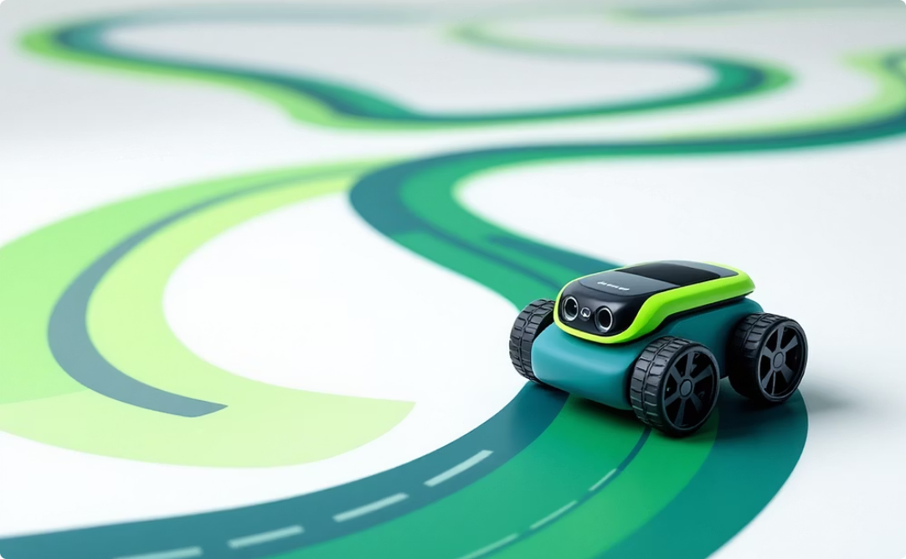
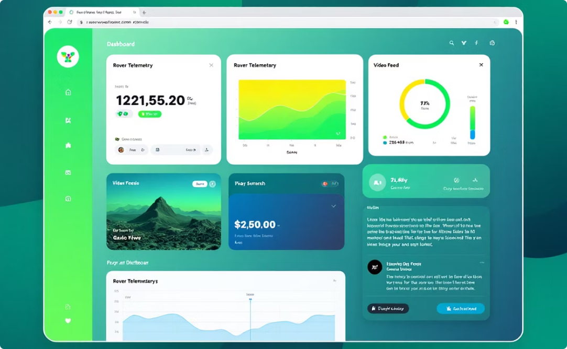

Outcomes & Deliverables
Autonomous Path-Following
Live Monitoring Platform
Firebase Integration
Cloud-based logging and
remote access
Rover consistently tracks black tape route
Real-time control and
status updates

Slide 20

Future Scope
Obstacle Detection
Mobile App Control
Sensor-based avoidance system
Cross-platform interface
1
2
3
4
Multi-rover Coordination
GPS Navigation
Outdoor pathfinding capabilities
Swarm behavior for industrial use

